Slide 1
Title: Industrial Human Resource Geo-Visualization
Subtitle: Analyzing Workforce Distribution Across India
GitHub Repo : https://github.com/Thejasrajsathyamoorthy/Industrial-Human-Resources
Thejas Raj A S
MDTM22

Slide 2
Problem Statement
Objective:
To update the industrial classification of main and marginal workers by sex, section, division, and class.
Provide accurate and relevant data for policy-making and employment planning.
Key Challenges:
Outdated workforce classification data.

Slide 3
Dataset Description
Source: Provided datasets with CSV files for each state.
Key Features:
State-wise counts of main and marginal workers.
Classification based on industry type, sex, rural/urban distribution.
Size: Combined shape after merging is 195145*25.

Slide 4
Technologies and Tools Used
Data Manipulation and Analysis:
pandas, numpy
Visualization:
matplotlib, seaborn, plotly.express
NLP and Machine Learning:
sklearn, TfidfVectorizer, Kmeans
Webpage:
Streamlit

Slide 5
Approach
Data Preparation:
Merging multiple state-wise datasets.
Cleaning and standardizing column names.
Feature Engineering:
Creating new features like ‘total_workers’.
Exploratory Data Analysis (EDA):
Understanding workforce distribution across industries and states.
Natural Language Processing (NLP):
Grouping industries into clusters using TfidfVectorizer and KMeans.
Web Application:
Building interactive dashboards using Streamlit and Plotly.

Slide 6
Data Cleaning
Steps Taken:
Removed invalid entries (e.g., "Blank", "Total", etc.).
Cleaned backticks (```) in categorical columns.
Result: Clean and structured data ready for analysis.

Slide 7
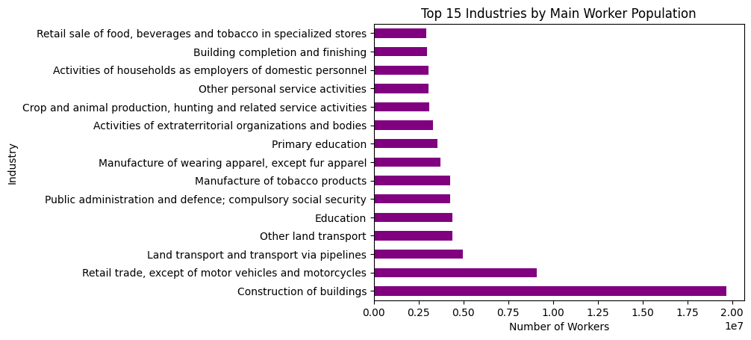
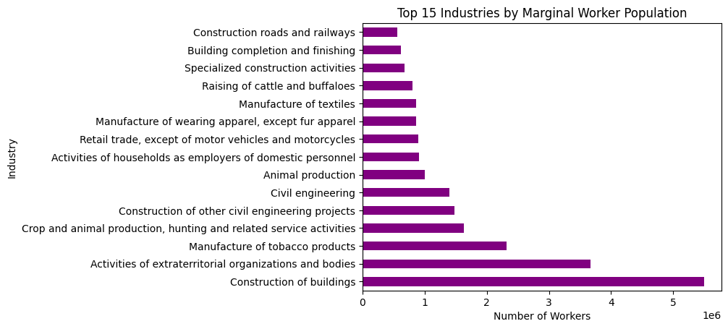
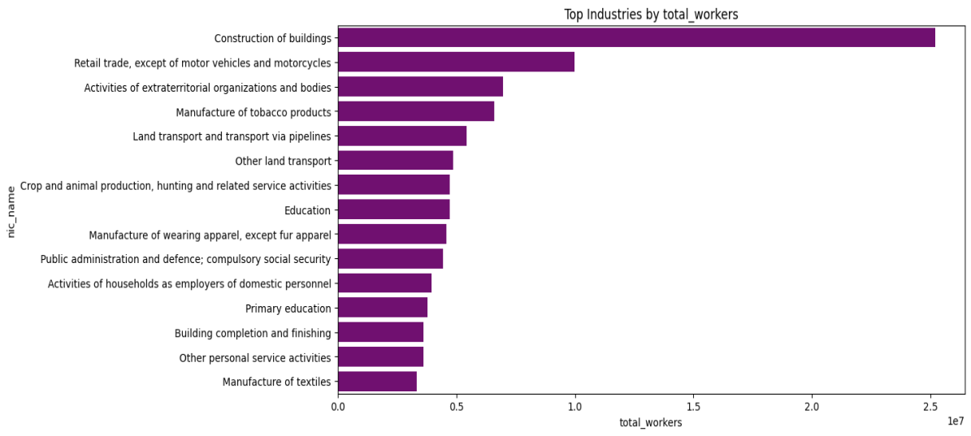
EDA Insights
1.Top 15 Industries by Workforce

Slide 8
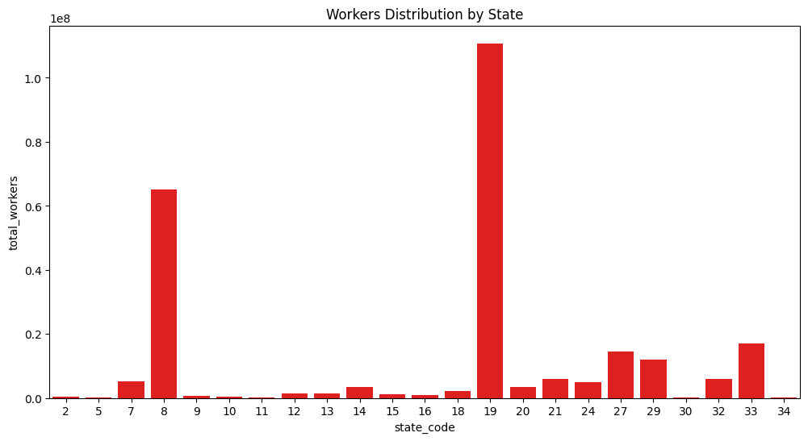
2. State-wise Distribution

Slide 9
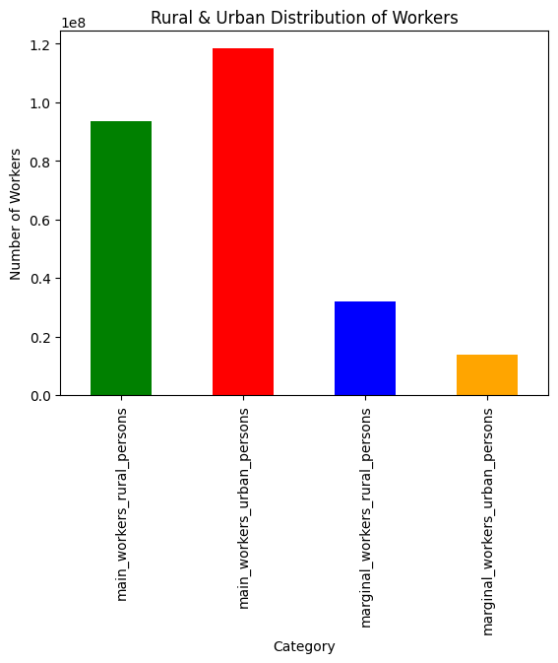
3. Rural & Urban Workforce

Slide 10
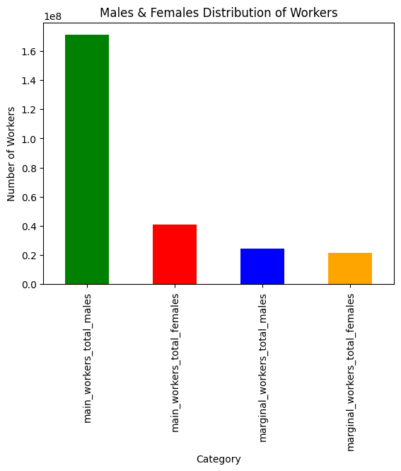
4. Males & Females Workforce

Slide 11
NLP Insights
Approach:
Extracted features from ‘nic_name’ using TfidfVectorizer.
Clustered industries into 5 groups using KMeans.
Industry Groups Identified:
0: 'Developmental works',
1: 'Manufacturing',
2: 'Automobile Industries',
3: 'Household works',
4: 'Retails'

Slide 12
Geo-Visualization Dashboard
Developed Using:
Streamlit for UI.
Plotly for interactive visualizations.
Features:
View workforce distribution by:
State
District
Division
Group
Class

Slide 13
Conclusion
Impact:
Provides updated workforce insights.
Aids in policy-making and employment planning.
Next Steps:
Include real-time workforce updates.
Extend industry classification with deep learning techniques.
Integrate advanced geospatial visualizations.

Slide 14
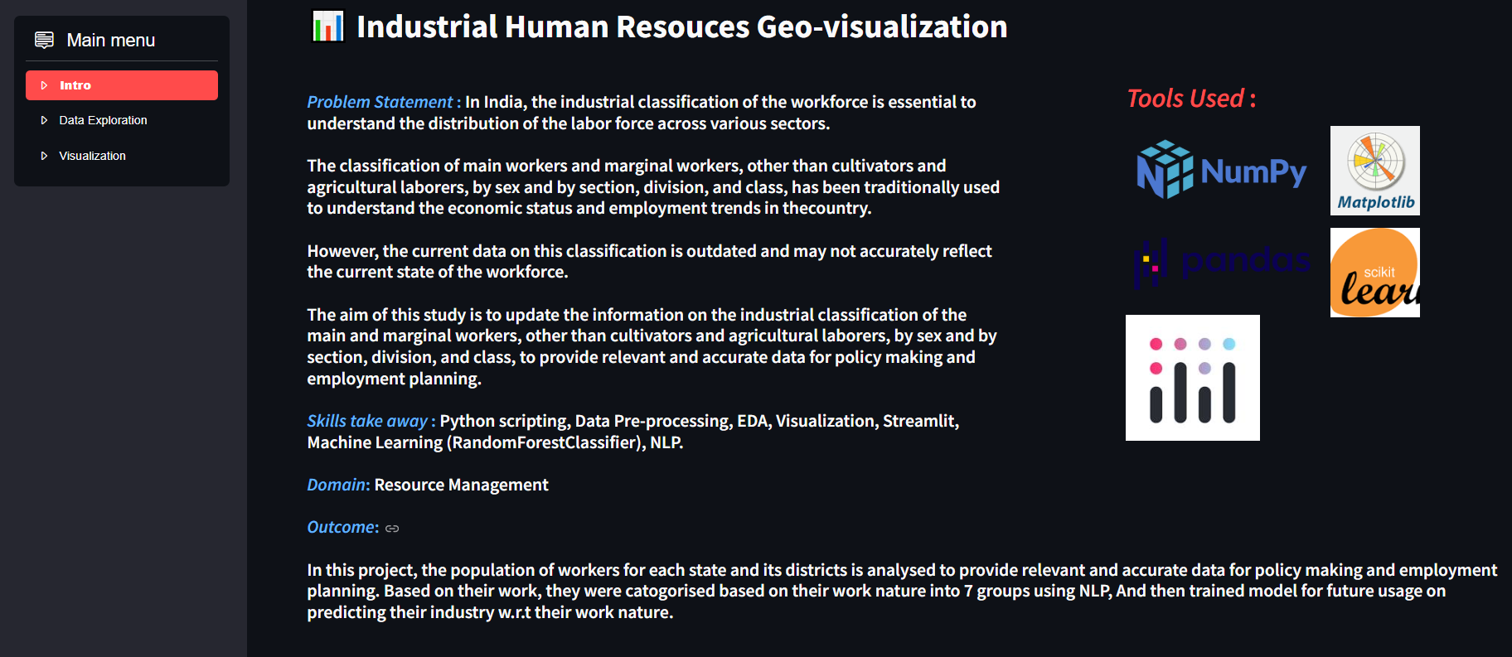
Snaps of Webpage

Slide 15
